Slide 1
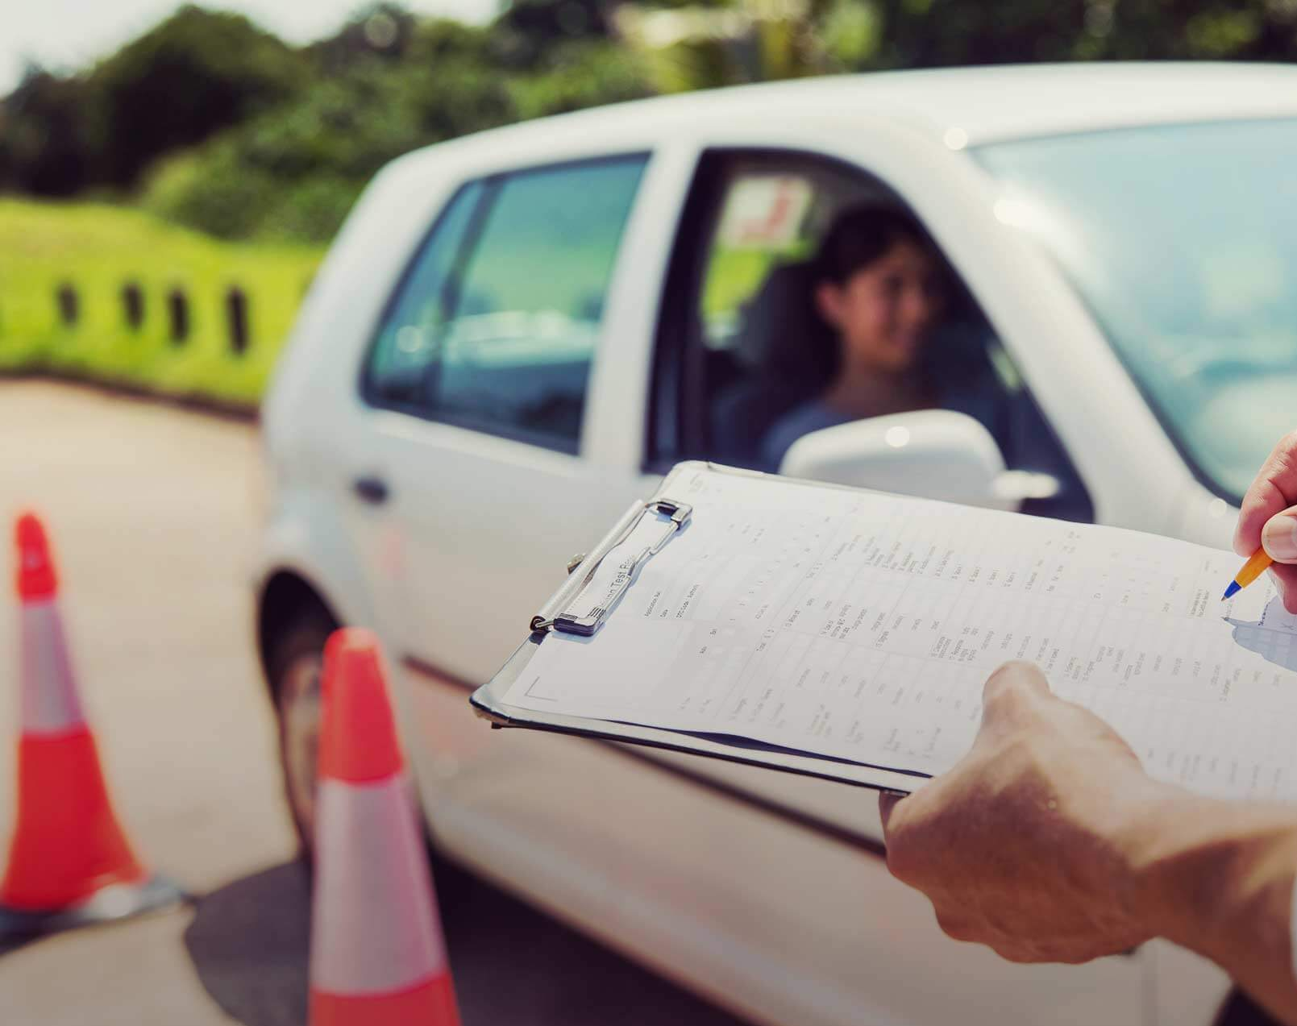
The DriverPass System
Design And Presentation By Christopher Harvestine

Slide 2
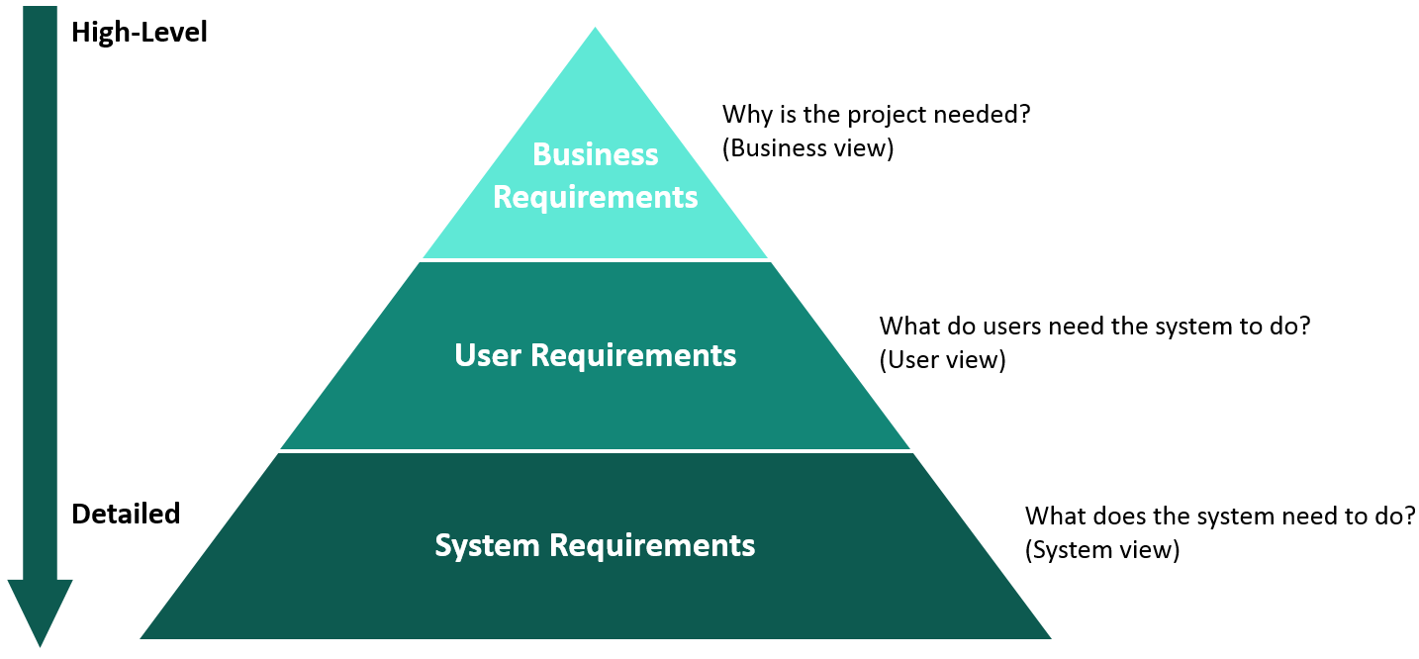
System Requirements
Performance Requirements:
Program will run on cell phones 3 generations back
Will support IOS,Windows and web browsers
Must have access to the internet

Slide 3
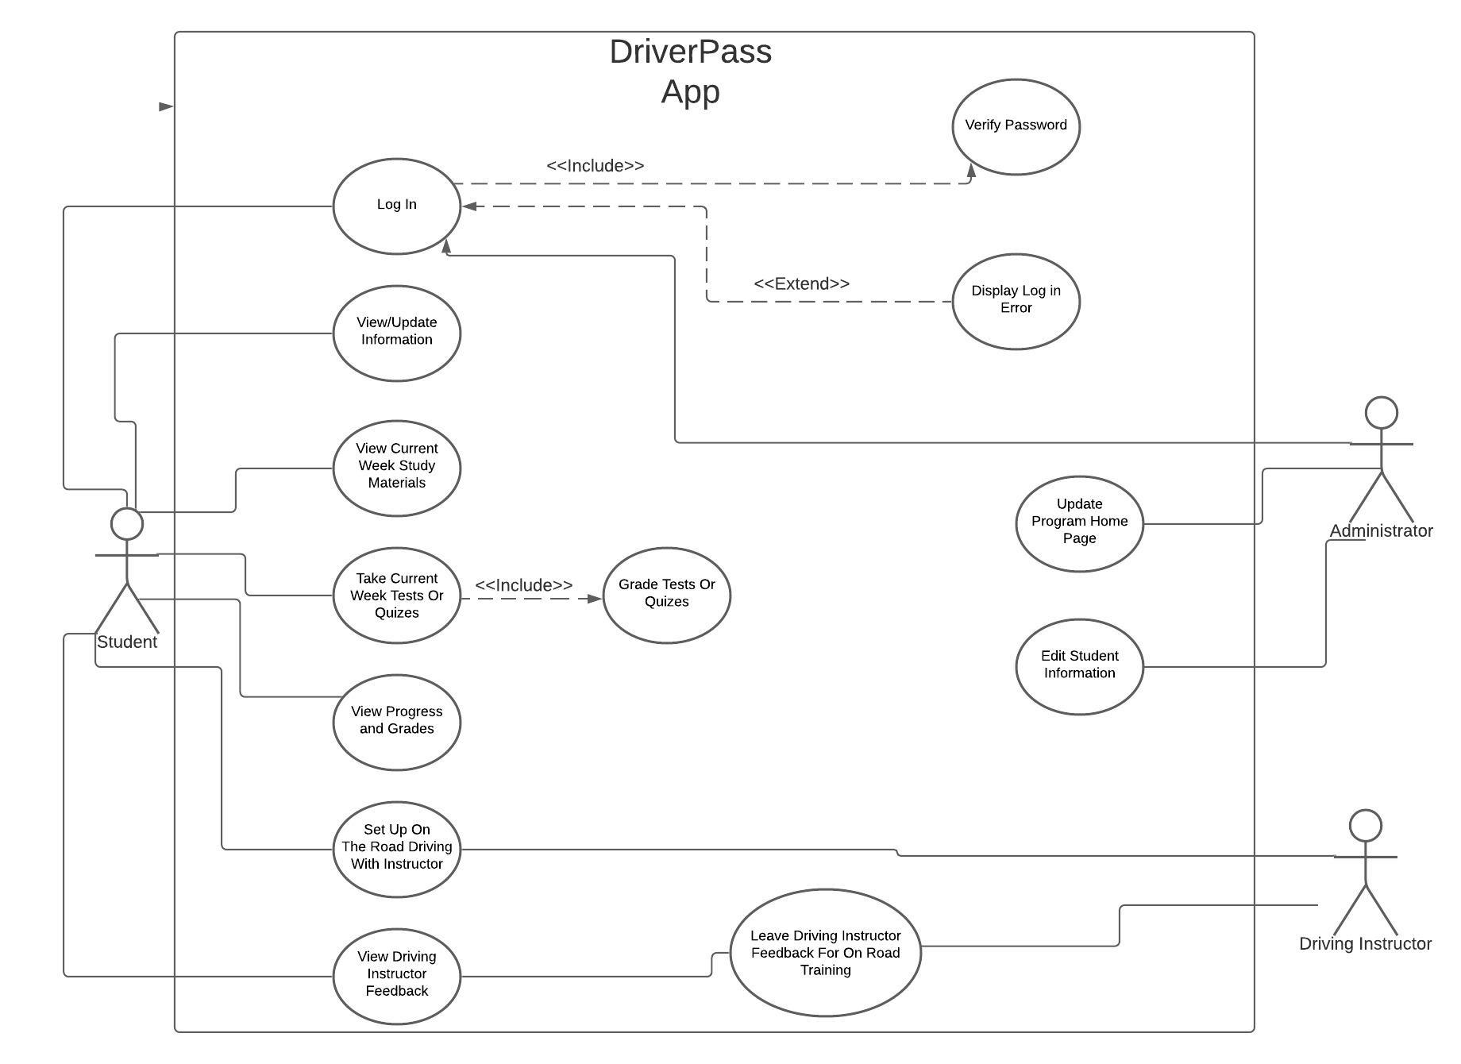
Use Case Diagram
3 Different Users:
Student
Administrator
Driving Instructor
This diagram shows the various interactions each user may have with the DriverPass system as well as each other.

Slide 4
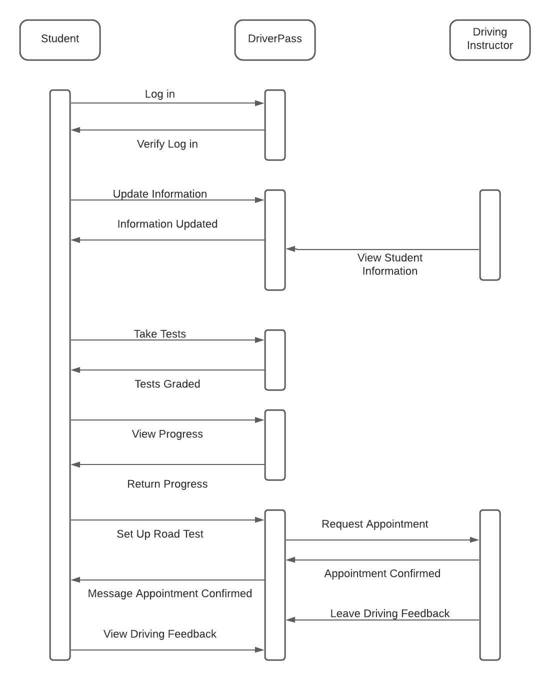
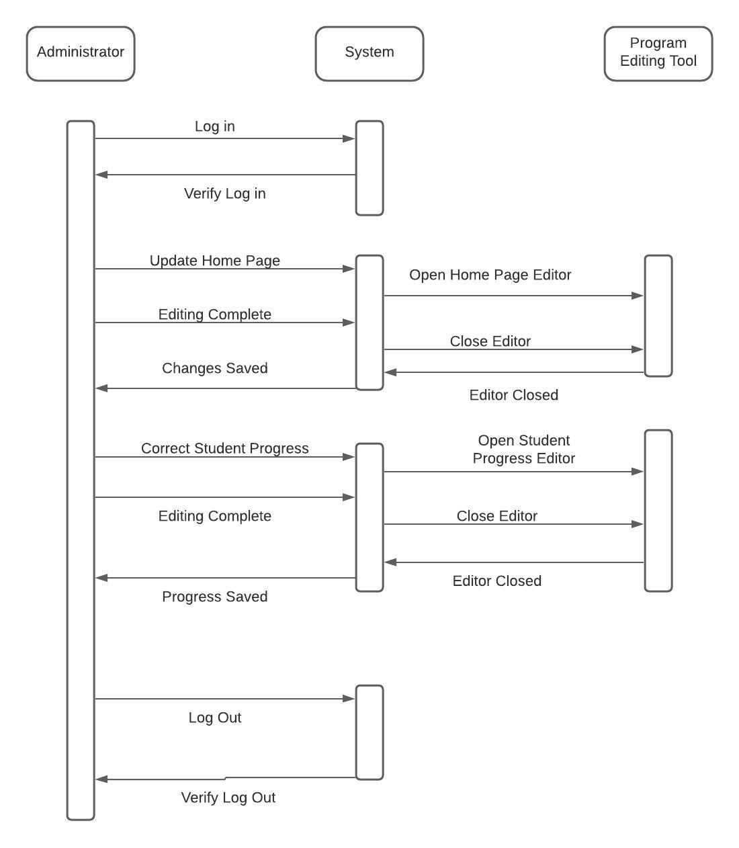
Activity Diagram

Slide 5

Security
Security Features:
Case Sensitive User Name
Case Sensitive Password
Email Address Needed For Password Reset
User’s account locks after 10 failed attempts to sign on
The Program Will Utilize A VPN For Increased Protection

Slide 6
System Limitations
Not All Hardware Will Run The Program
Internet Access Required
Not All Operating Systems Will Run The Program
Optimization On Supported Platforms May Impact The Budget

